Slide 1

BUSINESS DATA MANAGEMENT CAPSTONE PROJECT
Data-Driven Analysis and Optimization for Enhanced Sales
Name: Shivam Yadav
Roll number: 20201106

Slide 2
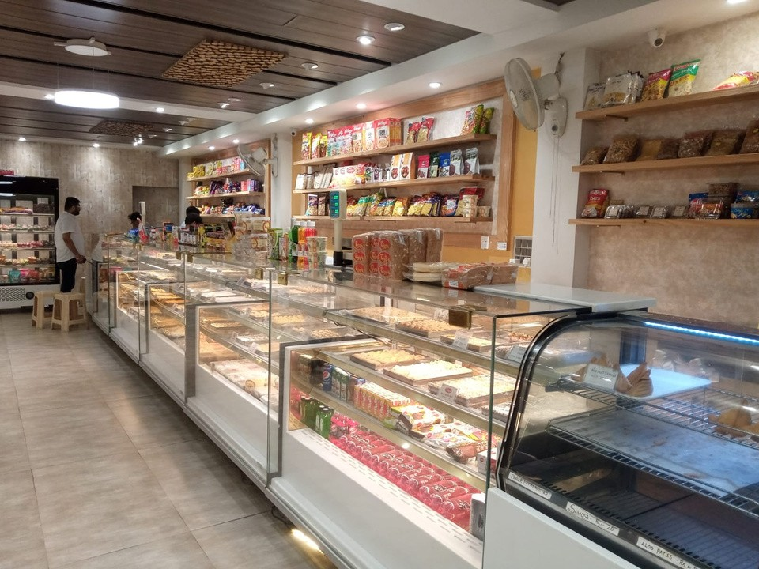

THE BUSINESS
The company started 150 years ago, se ling sweets and namkeens
This new outlet is located near my house, on a bypas road, Etawah and has a limited number of households in the vicinity
It se ls sweets, namkeen, bakery, and confectionery

Slide 3

Data Collection and Analysis Process
Identified busines problems through shop visits and discus ions with Mr. Siddhant Khandelwal.
Co lected relevant data, including product data for 75 sweets and sales data for the financial year 2022-2023.
Consolidated and cleaned the data in Google Sheets for further analysis.
Analyzed the data using Tableau and Python libraries (NumPy, Pandas, Matplotlib, Seaborn) to gain insights and addres the identified problems.
Utilized various data analysis and visualization techniques to present findings and develop actionable recommendations.

Slide 4

OBJECTIVES
Objective I: Analyzing the Viability of the Sweet Shop
Objective I : Optimizing Sales Channels: Online Delivery vs. Of line Takeaway
Objective I I: Product Portfolio Optimization for Revenue Generation

Slide 5
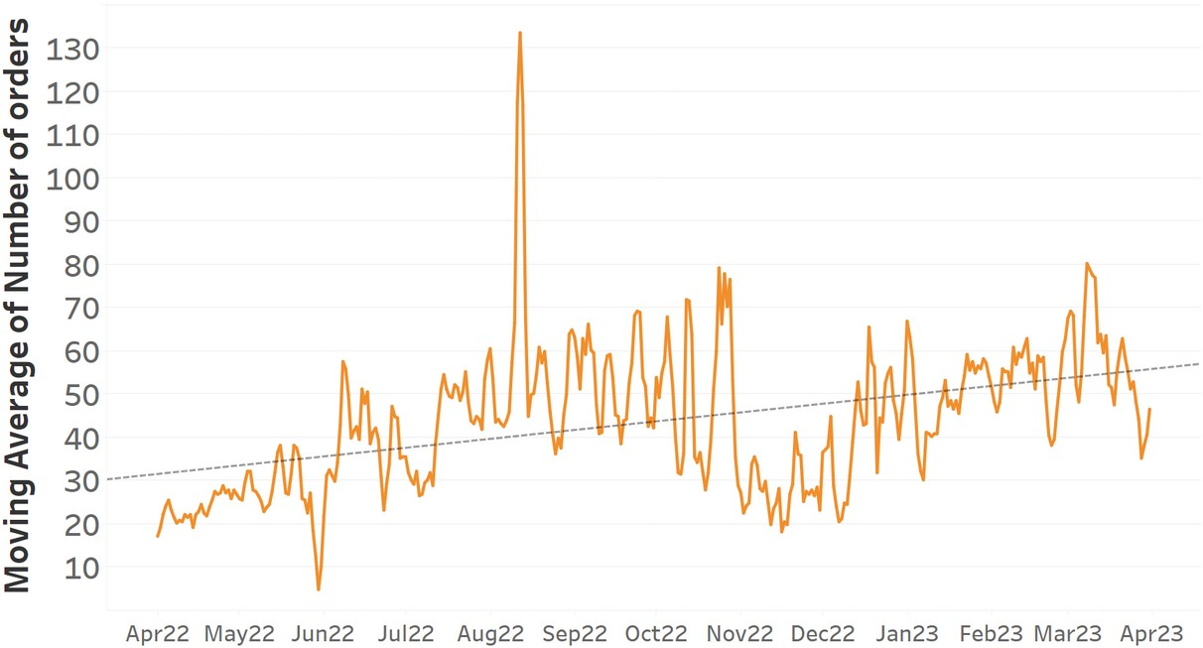
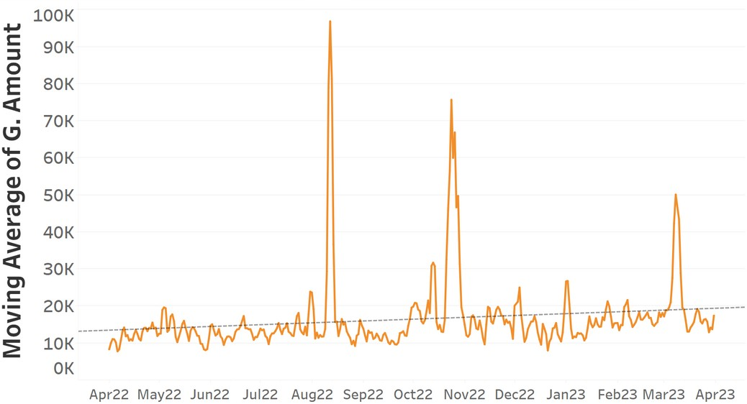
Volume & Revenue Trend over Time
Daily Average Volume Trend Daily Revenue Volume Trend
Date Date
Observations
The results indicate positive busines performance, with growth in average daily revenue and volume . There are significant peaks during festive occasions.
Line chart shows the trend in data over time

Slide 6
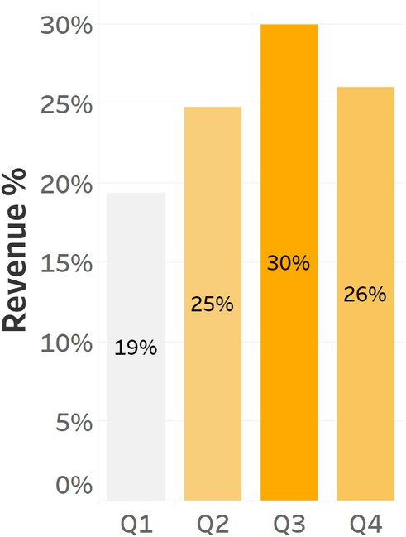
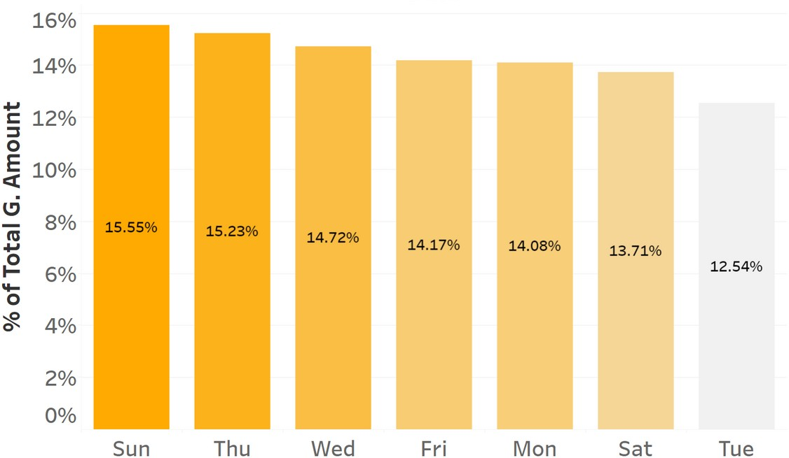
Volume & Revenue Trend over Time
Quarterly Revenue Growth Rate
Weekly Revenue % distribution
Observations
The revenue generated over quarters has increased.
Sti l Revenue % on Fri and Sat are les as expected.
Quarter
Day
Bar Chart is used to compare data acros categories or tracking changes over time

Slide 7
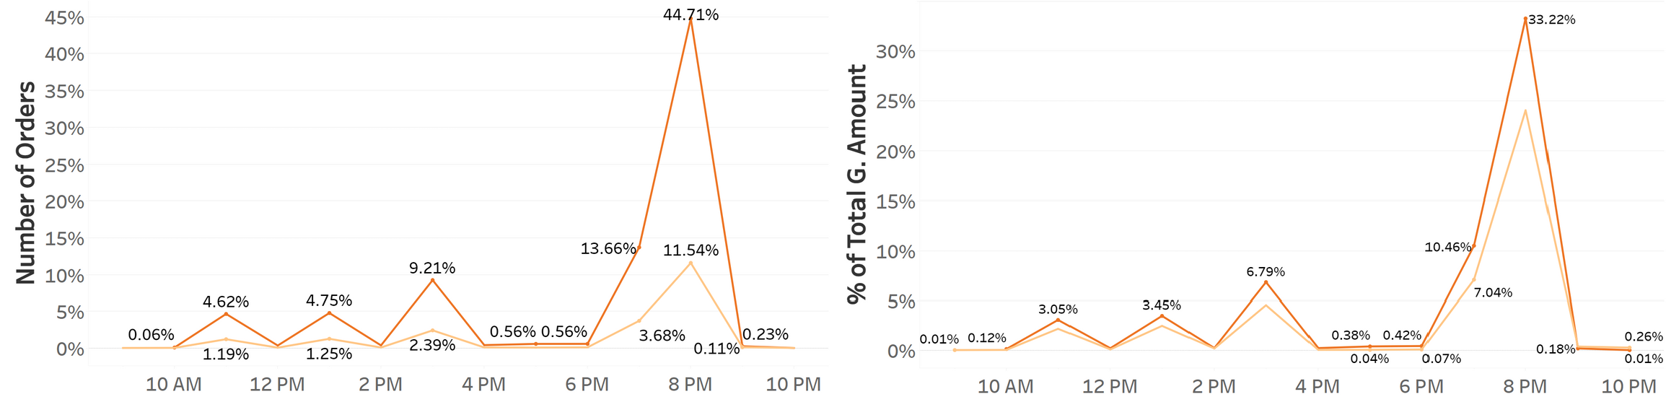

Order Frequency & Revenue by Time of Day
Time of Day Time of Day
Observations
The highest number of orders are placed between 7-9 PM. This suggests the need for developing targeted strategies and promotions during this time interval to maximize sales and customer engagement.
Line chart shows the trend in data over time

Slide 8
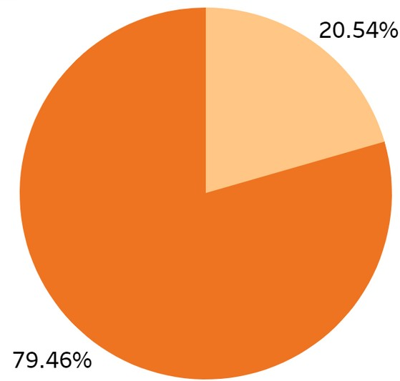
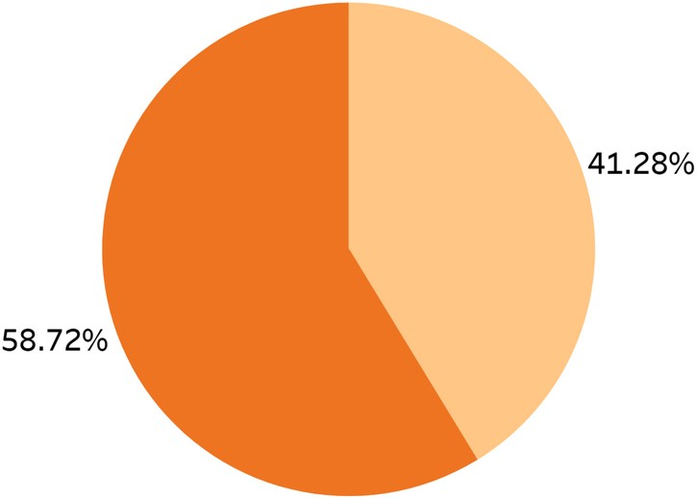
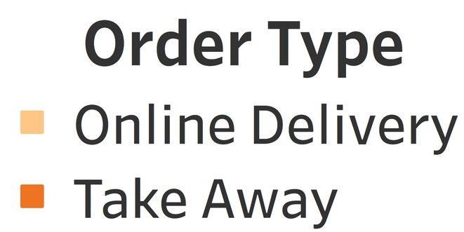
Order Type Distribution
Observations
Volume
Revenue
The chart shows that online delivery orders account for approximately 20% of the total number of orders but contribute to around 40% of the revenue.
This indicates that online orders have a higher average order value and result in a more significant revenue impact.
Average Revenue per Order Online Delivery: Rs. 753.6 Take Away: Rs. 277.1
Pie Chart display the proportion or percentage of dif erent parts to the whole

Slide 9
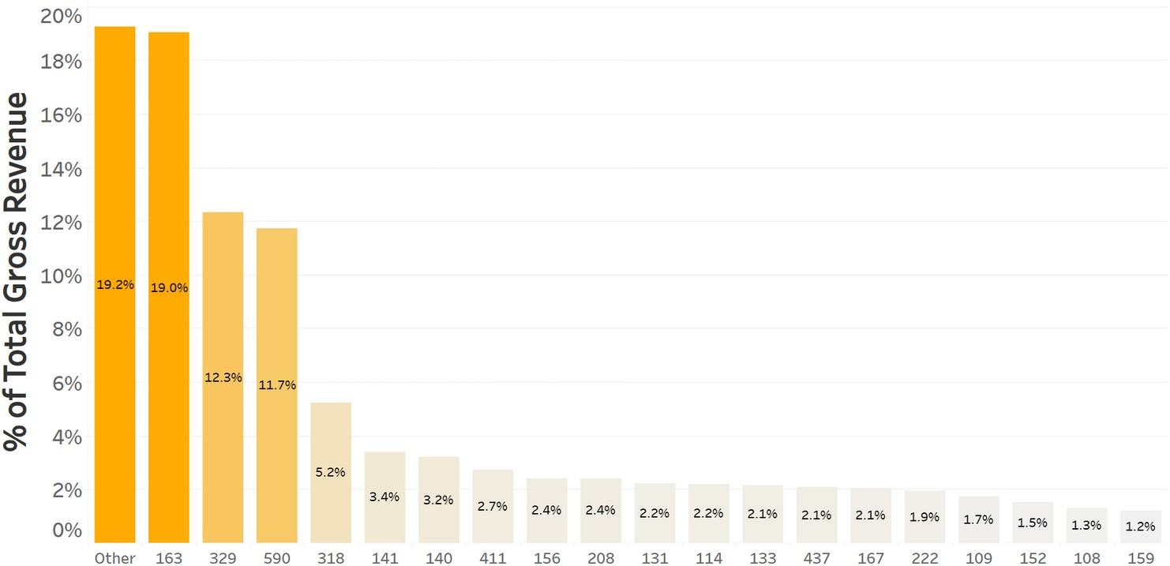
PARETO ANALYSIS OF REVENUE BY
PRODUCT
Observations
The top 20% of products contribute to approximately 80% of the total revenue. In contrast, the "Other" 80% of products only generate around 20% of the revenue.
Product Code
Pareto Chart or 80/20 rule Shows major contributors and identified areas of focus

Slide 10


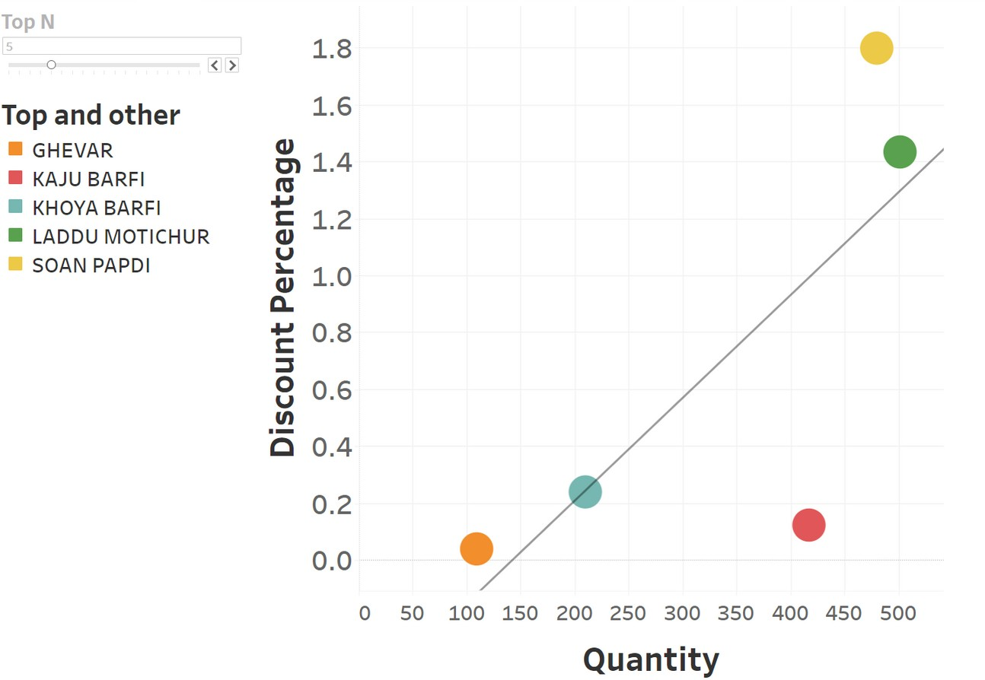

Discount % Vs Quantity Sold
Observations
The analysis reveals a positive cor elation between discount percentage and quantity sold for the top 5 revenue-generating items. Therefore put ing discounts on these products may yield high revenue.
Scat er Chart shows the relationship between two numeric variables using dots

Slide 11
RECOMMENDATIONS
Objective I: Analyzing the Viability of the Sweet Shop Capitalize on Festive Seasons
Enhance Weekend Sales
Target Peak Hours
Objective II: Optimizing Sales Channels: Online Delivery vs. Offline Takeaway Enhance the Online Delivery Experience
Customer Database and Loyalty Programs for Takeaway
Objective III: Product Portfolio Optimization for Revenue Generation Product Assortment Optimization: Focus of top 20% Products Discount and Promotional Strategies
Continuous Quality Control
Customer Feedback and Analysis

Slide 12
THANK YOU

